Slide 1
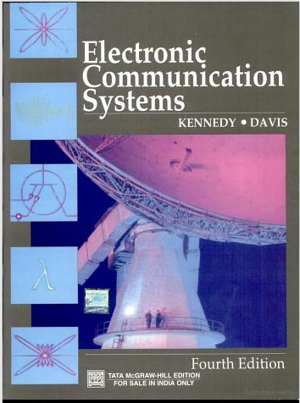
Part - III Principles of Electronic Communication
Chapter-8: Introduction to Digital Communication
Reference:
Electronic Communication Systems by
Kennedy & Davis ,
4th edition,2004,TMH Edition

Slide 2
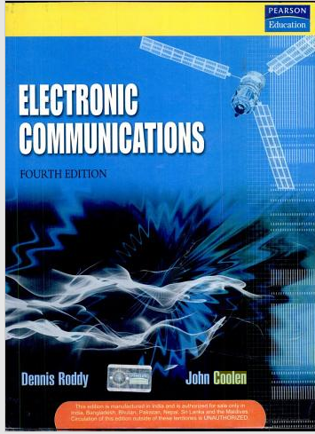
Chapter – 8 Introduction to digital communication
Reference :
Electronic Communications
by Denis Roddy & John Coolen ,
4th edition, Pearson Education,2009

Slide 3
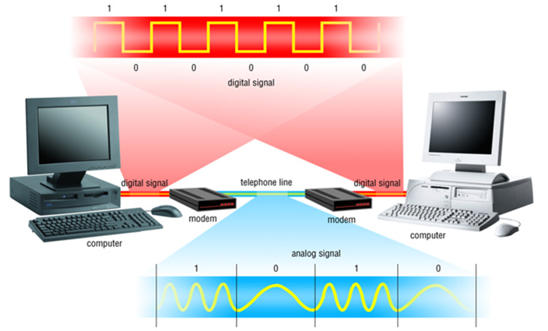
INTRODUCTION TO DIGITAL COMMUNICATION
Source: www.sonoma.edu/users/f/farahman/sonoma/courses/.../introduction.ppt

Slide 4
Digital Communication-Introduction
Objectives:
State Nyquist Sampling Theorem
Explain the principle of Pulse Amplitude Modulation Techniques
Explain the function blocks of a Digital Communication System
Mention advantages & disadvantages of Digital Modulation
Explain the principle of different types of Digital Modulation Techniques

Slide 5
Module 1 : Digitization of Analog signals

Slide 6
Sampling
Introduction
Sampling Examples in real world situations
Sampling for Analog-to-Digital Conversion

Slide 7
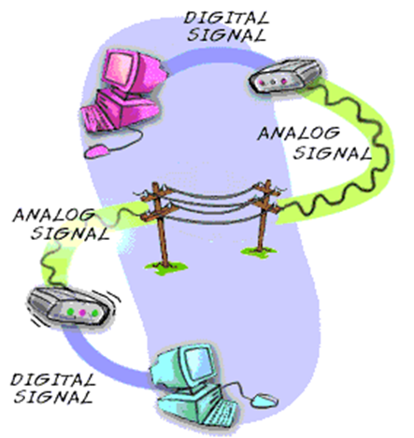
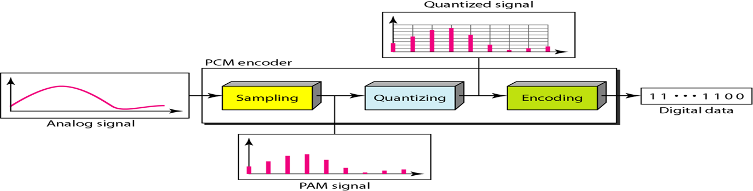
Sampling
Steps involved in Analog to Digital
Conversion
Sampling (sampling.docx )
Quantizing Source : http://www.jhigh.co.uk/ComputingSG/GPPs/Communications
Encoding
Source:: 112.196.5.130/edusat/poly/Electrical/sem-/Pulse%20Modulation.ppt

Slide 8
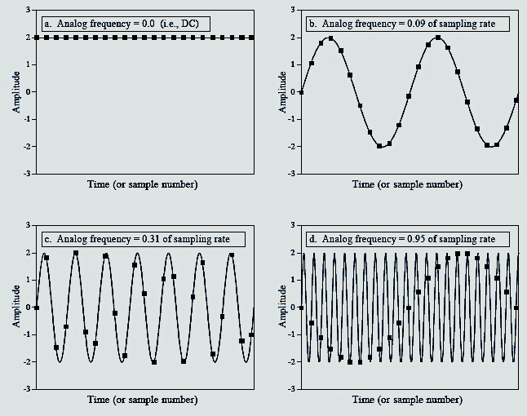
Sampling Illustration
Nyquist Sampling Theorem Statement
“It is possible to reconstruct a band-limited analog signal from periodic samples, as long as the sampling rate is at least twice the highest frequency component of the signal.”
Source: http://www.dspguide.com/ch3/2.htm
Notes:
Aliasing in sampling
Due to being sampled at an insufficient frequency, the signal takes on a different persona or a false presentation.
The sampling of a composite signal composed of many frequency components, the Nyquist sampling rate needed to avoid aliasing is just twice the highest frequency component present in the composite signal.
For ex, if a composite signal is composed of sine waves at frequencies 1Hz, 2Hz, and 3Hz , then according to the Nyquist sampling theorem, this signal must be sampled at 6Hz.

Slide 9
Self Test
1. Why sampling is required?
It is required for modulation.
It is necessary to suppress the effect of noise in communication channel.
Sampling is necessary before an analogue signal can be converted into digital form.
Without sampling, a signal can’t be transmitted and stored.
2. Why data is preferred in digital form?
Because in digital form, the effect of noise can be cancelled easier.
Because in digital form, error control, data security and compression are possible.
Because digital devices are easier to design and implement.
All reasons are correct.

Slide 10
ACTIVITY:
Try and find out the effect of sampling of a sinusoidal signal if the signal frequency is equal to , less than and more than the Nyquist sampling frequency.

Slide 11
Pulse Modulation Techniques
Digital Transmission of Analog Data
Types of Digital Transmission
Pulse Amplitude Modulation (PAM)
Pulse Width Modulation (PWM)
Pulse Position Modulation (PPM)
Pulse Modulation Techniques.docx

Slide 12
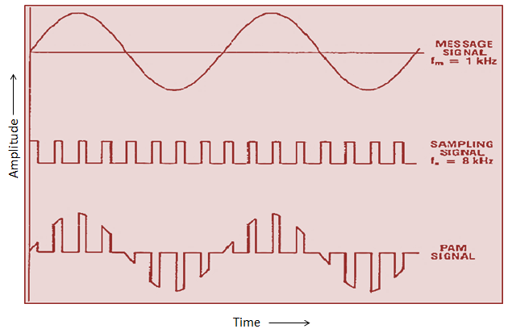
Pulse Amplitude Modulation (PAM)
Notes:
Pulse Amplitude Modulation (PAM)
Pulse Amplitude Modulation (PAM) is the simplest form of pulse modulation. Here the signal is sampled at regular intervals and each sample is made proportional to the amplitude of the signal at the instant of sampling.

Slide 13
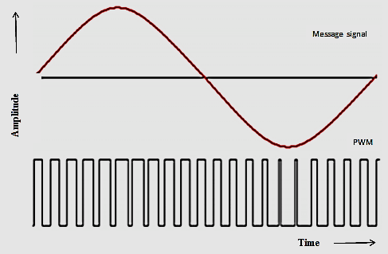
Pulse Width Modulation (PWM)
Notes:
Pulse Width Modulation (PWM)
The Pulse Width Modulation is also called Pulse Duration Modulation (PDM). Here the amplitude and starting time of each pulse is fixed but the width of each pulse is made proportional to the amplitude of the signal at that instant.
Pulse Position Modulation (PPM)
In this method, both the amplitude and the duration are kept constant while the position of each pulse in relation to the position of a recurrent reference pulse is varied by each instantaneous sampled value of the modulating wave.

Slide 14
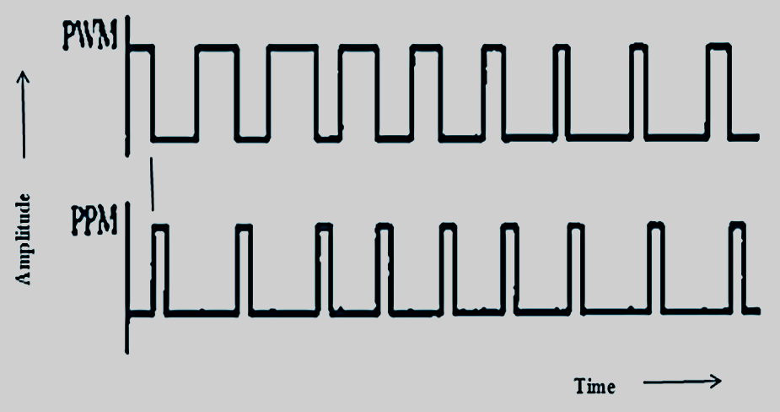
Pulse Position Modulation (PPM)

Slide 15
Self Test
1. Pulses are often used to transmit information because
pulses often require less energy for transmission than analog signals.
pulses are often less affected by noise than analog signals.
With pulses, several messages can be transmitted on the same channel.
all of the above.
2. In pulse modulation, the parameters usually made to vary in proportion to the message signal are
rise time or overshoot.
amplitude or frequency.
amplitude, width or position.
all of the above.
3. Differentiate between pulse modulation and continuous modulation

Slide 16
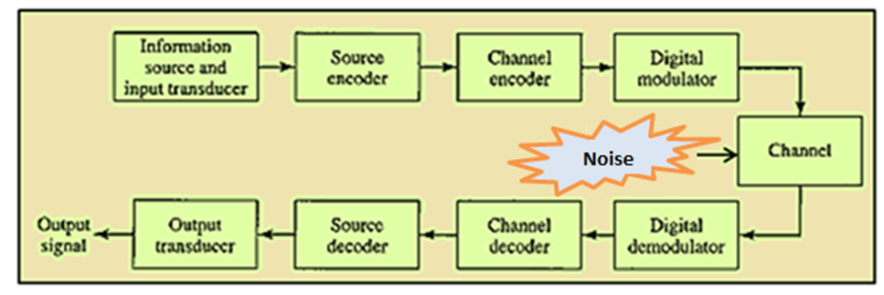
Digital Communication Contd.,
Need for Digital Modulation
Block Diagram of a Digital Communication System
Digital Communication System.docx
Notes:
Fig shows the functional elements of a digital communication system. The function of each block is explained as follows:
Information Source
Many of the real world signals are physical in nature. Examples of physical parameters are voice, speech, image etc. The input transducer used to convert voice, speech or music signal or image to an electrical signal. Examples of input transducers are microphone, camera etc.
Source Encoder / Decoder
The aim of the source coding is to represent the digital signal efficiently with as much less number of bits as possible. The source decoder performs the inverse operation of source encoder.
Channel Encoder / Decoder
Channel coding and decoding helps in detecting and/or correcting the errors in the received data that gets introduced during transmission.
Modulator/ Demodulator
The Modulator converts the input digital information into an electrical waveform suitable for transmission over the communication channel. The extraction of the digital data from the received signal is accomplished by the demodulator.
Channel & Noise
The channels are either wired such as pair of wires, coaxial cable and optical fiber or wireless (free space) such as radio channel, satellite channel or combination of any of these.

Slide 17
DIGITAL COMMUNICATION Contd.,
Advantages of Digital Communication
Distortion, noise and interference
Use of Regenerative repeaters
Reliability
Flexible & Compatible hardware implementation
Secrecy of information.
Error detection and Error correction
Multiplexing of several channels
Availability of wideband channels
Increased system complexity in a cost effective manner
Notes:
Advantages of Digital Communication
Distortion, noise and interference
Use of Regenerative repeaters
Reliability
Flexible & Compatible hardware implementation
Secrecy of information.
Error detection and Error correction
Multiplexing of several channels
Availability of wideband channels
Increased system complexity in a cost effective manner
Disadvantages of Digital Communication
1. Large System Bandwidth
2. System Synchronization
3. Circuit Complexity

Slide 18
DIGITAL COMMUNICATION Contd.,
Disadvantages of Digital Communication
Need for Large System Bandwidth
Need for System Synchronization
Circuit Complexity
Refer Advgs & Disadvgs of Digital Communication.docx
Notes:
Advantages of Digital Communication
Distortion, noise and interference
Use of Regenerative repeaters
Reliability
Flexible & Compatible hardware implementation
Secrecy of information.
Error detection and Error correction
Multiplexing of several channels
Availability of wideband channels
Increased system complexity in a cost effective manner
Disadvantages of Digital Communication
1. Large System Bandwidth
2. System Synchronization
3. Circuit Complexity

Slide 19
DIGITAL MODULATION TECHNIQUES
Types of digital modulation techniques
Amplitude Shift Keying (ASK)
Frequency Shift Keying (FSK)
Phase Shift Keying (PSK)
Refer Digital Modulation Techniques.docx
Notes:
In all the above modulation techniques, the digitized information get mapped into either the amplitude or phase or frequency of the sine wave carrier and then transmitted. Here At the receiver , the modulated sine wave carrier is remapped back to the information.

Slide 20
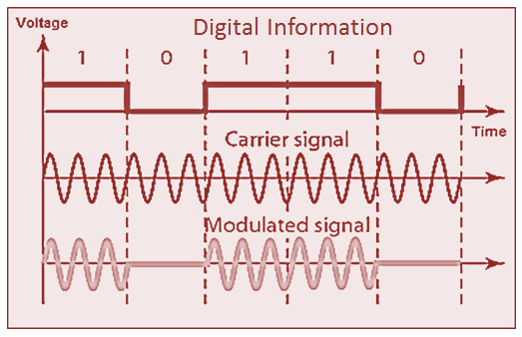
AMPLITUDE SHIFT KEYING (ASK)
Notes:
Amplitude Shift Keying (ASK)
Here the amplitude of the sinusoidal carrier is changed in response to information while the frequency and phase are kept fixed. Bit 1 is transmitted by a carrier of one particular amplitude. Bit 0 is transmitted by changing the amplitude ( 0 Volt or no signal in this case).

Slide 21
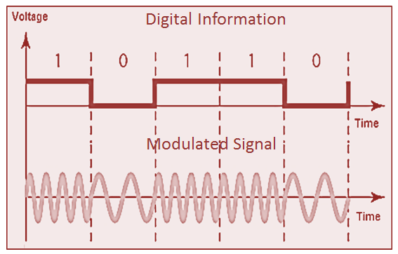
FREQUENCY SHIFT KEYING (FSK)
Notes:
Frequency Shift Keying (FSK)
Here the frequency of the sinusoidal carrier is changed in accordance with the binary information. ie., one particular frequency for bit 1 and another frequency for
bit 0.

Slide 22
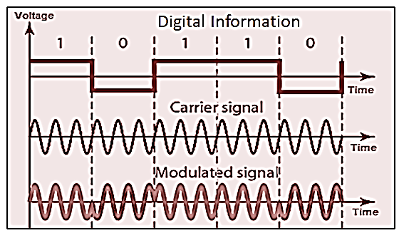
PHASE SHIFT KEYING (PSK)
Notes:
Phase Shift Keying (PSK)
Here the phase of the sinusoidal carrier is changed in accordance with the binary information. Phase in this context is the starting angle at which the sinusoid starts. To transmit 0, we shift the phase of the sinusoidal carrier by 180º.

Slide 23
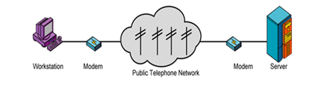
Application of ASK, FSK AND PSK
Applications : ASK
Transmission of digital data over optical fiber
Used as a type of modulation called On-Off Keying at radio frequencies
Application : FSK
Variant of FSK (GMSK) in GSM Mobile Stds
Amateur radios, Modems , Caller ID’s etc.,
Application :PSK
Variants of PSK in Wireless LAN stds , Bluetooth stds, RFID’s , Zig bee etc.,
Source: www.sonoma.edu/users/f/farahman/sonoma/courses/.../introduction.ppt

Slide 24
Self Test
1 In _______, the peak amplitude of one signal level is 0; the other is the same as the amplitude of the carrier frequency.
PSK
ASK
FSK
none of the above
2 How many carrier frequencies are used in Binary FSK?
2
1
0
none of the above

Slide 25
Summary
In this module we have learnt:
To state Nyquist sampling theorem (fs≥2fc, Where f_{s} is the sampling frequency and f_{c} is highest frequency contained in the signal) and apply this theorem to determine the sampling rate for sampling an analog signal without distortion.
To define and distinguish various types of pulse modulation techniques such as PAM, PWM and PPM
Draw and explain the various blocks of a General Digital Communication System
To define, draw and distinguish different digital modulation techniques such as ASK, FSK and PSK.

Slide 26
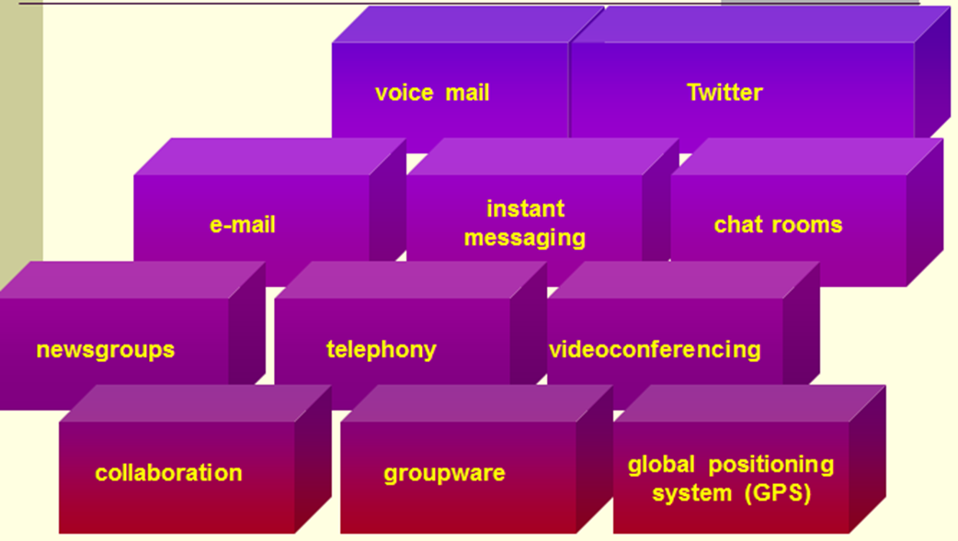
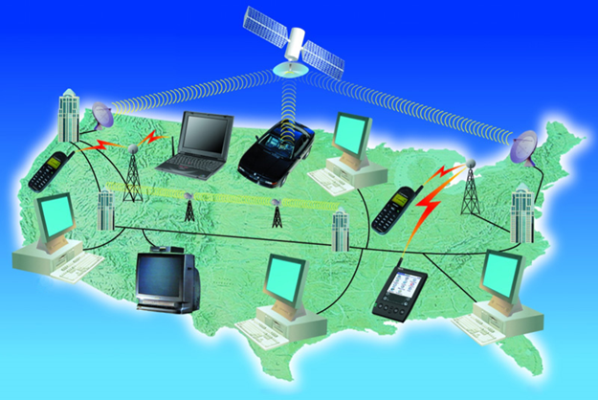
Applications of Digital Modulation To Communication Technologies
Source: www.sonoma.edu/users/f/farahman/sonoma/courses/.../introduction.ppt
Notes:
Simplex
AM and FM broadcasting
Digital radio
TV broadcasting
Digital television (DTV)
Cable television
Facsimile
Wireless remote control
Paging services
Navigation and direction-finding services
Telemetry
Radio astronomy
Surveillance
Music services
Internet radio and video
Duplex
Telephones
Two-way radio
Radar
Sonar
Amateur radio
Citizens radio
Family Radio service
The Internet
Wide-area networks (WANs)
Metropolitan-area networks (MANs)
Local area networks (LANs)

